Slide 1

PFIZER HR ATTRITION PREDICTOR RETAINING OUR SCIENTIFIC TALENT
Squad HR Analytics

Slide 2
TABLE OF CONTENTS
01
02
03
PROBLEM
SOLUTION
The Challenge of Employee Retention at Pfizer
Presentation & Demo
04
CYBERSECURITY
EXPLAINABLE AI
IA Act & GDPR compliance
Understand to Act

Slide 3
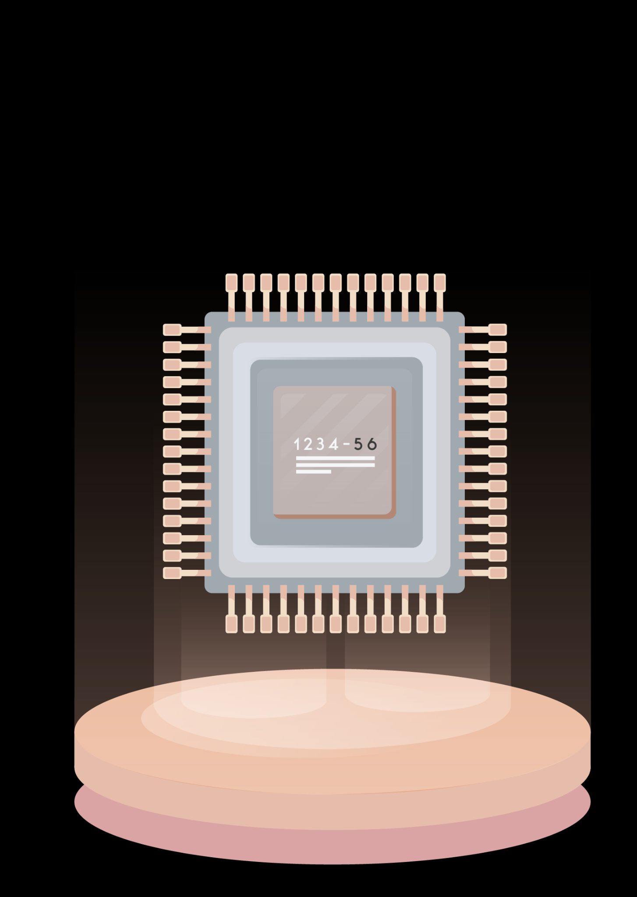
01
PROBLEM
The Challenge of Employee Retention at Pfizer

Slide 4
THE CHALLENGE OF EMPLOYEE RETENTION
OBJECTIVE
RISK
IMPACT OF TURNOVER
Brain drain of critical expertise (R&D, Regulatory Affairs, Supply Chain)
Direct slowdown in our innovation cycles
Significant increase in operating costs
In-depth analysis of the reasons for employee turnover.
Proactively retaining our strategic talent.
The highly sensitive nature of our colleagues' personal data.
Absolute protection, confidentiality, and compliance are essential.

Slide 5
02
SOLUTION
Presentation & Demo

Slide 6
OUR SOLUTION
A 3-step application process :
PROTECT
UNDERSTAND
ACT
Strict anonymization
Explainable AI
Suggestion engine
Goal : Secure HR data (GDPR compliance) and make model explainable and transparent

Slide 7
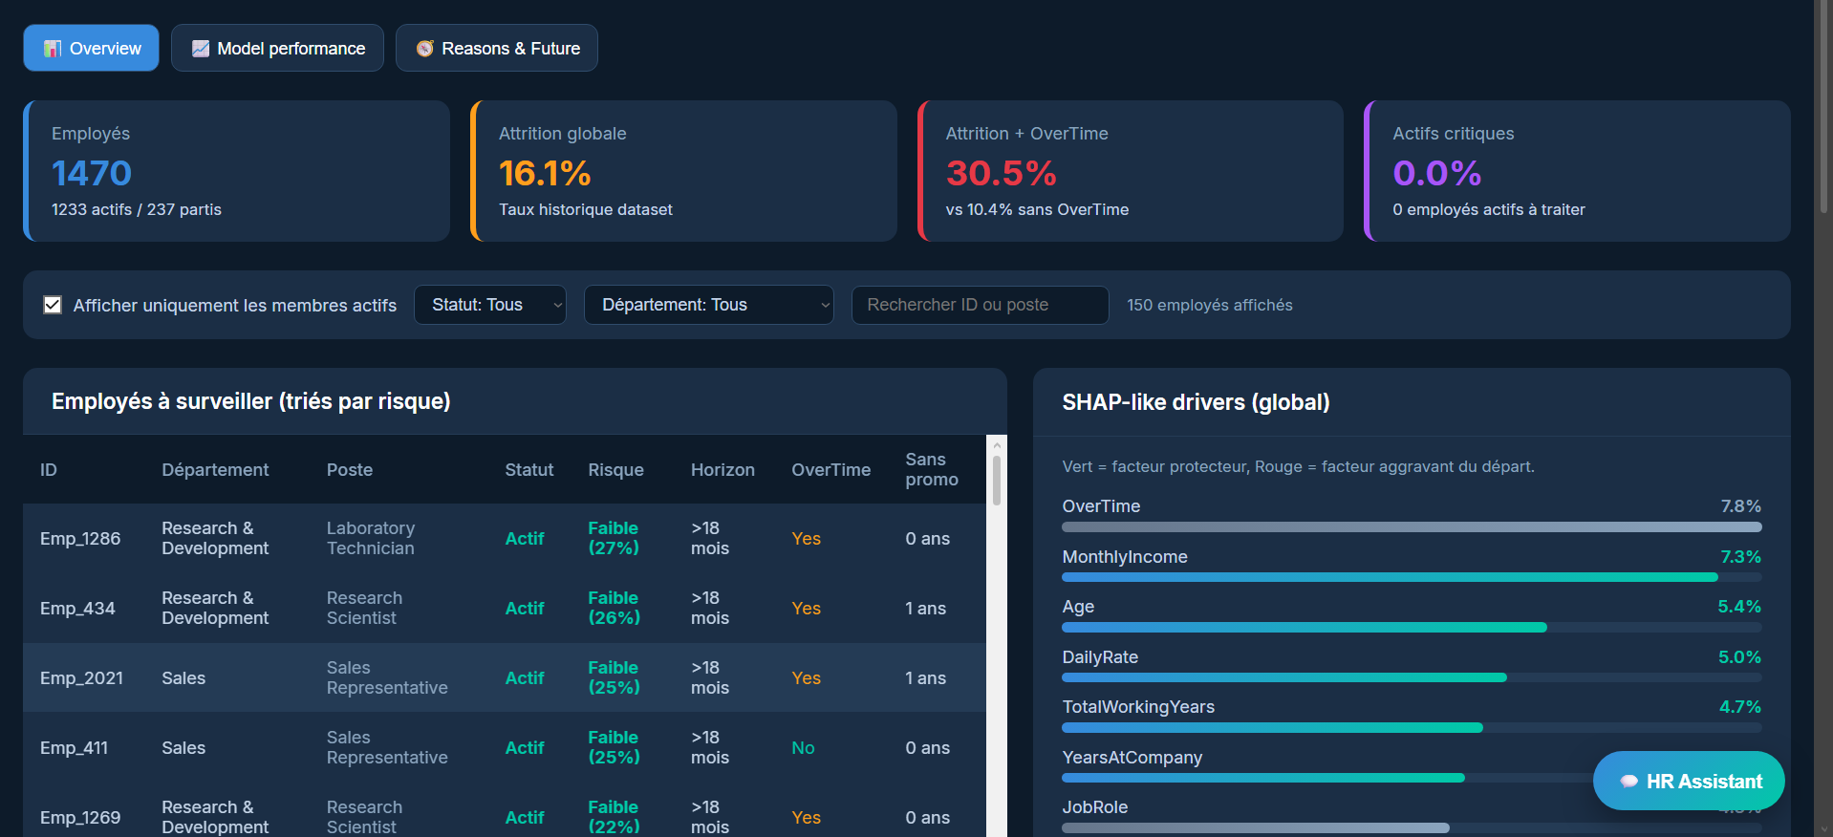
SOFTWARE DEMO

Slide 8
03
Cybersecurity
RGPD & AI Act (Protect the data)

Slide 9
CYBERSECURITY: RGPD & AI Act
STRICT ANONYMIZATION
AI Act
Complete removal of direct identifiers (e.g., employee numbers).
Anonymization of quasi-identifying data
Our AI has been classified as “High Risk” (HR category)
Guaranteed transparency and documented risk mapping
ETHICS
SOVEREIGNTY
Deliberate exclusion of highly sensitive data (e.g gender) from the training phase to ensure neutrality
100% on-premises processing and recommendations (no external cloud APIs)

Slide 10
04
Explainable AI
Understand to Act

Slide 11
EXPLAINABLE IA & TRANSPARENCY
END OF “BLACK BOX”
SHAP TECHNOLOGY
A solution designed to be fully understandable to our HR managers
Transparent, justifiable, and trustworthy results
Detailed analysis of influencing factors for each employee
Clear identification of the “why” (e.g., the exact impact of a low satisfaction score or delays)
SUGGESTION ENGINE
Immediate simulation of concrete preventive actions
Guaranteed human oversight: the AI suggests scenarios and the HR manager approves the action

Slide 12
CONCLUSION : BENEFITS OF OUR SOLUTION
1
2
3
LOWER RECRUITMENT COSTS
PRESERVING PFIZER’s EXPERTISE
CUSTOMIZED AND MEASURABLE HR INITITAIVES

